Slide 1
Flight Delay from January 2017 - July 2022
Neysha Pagan
Santiago Lampon
Brandon O’Linn
Justin Washington

Slide 2
Introduction
Traveling by plane is one of the fastest and most convenient modes of transportation. Traveling by air can turn a 15 hour drive from Columbus, Ohio to Tampa Bay, Florida into a brief two and a half hour flight. What customer don’t like about traveling by air is getting to and sitting in the airport for an hour or two just to have their flight delayed over and over. The Bureau of statistics reports that 20% of all flights are delayed by at least 15 minutes. The goal of this project is to help determine the best airlines and times to schedule a flight and minimize time spent in the airport.

Slide 3
About the data
The purpose of this analysis is to explore the Flight Delay from January 2017 - July 2022 dataset.
The dataset was obtained from Kaggle under the name of Flight Delay from January 2017 - July 2022.
The data covers a summary information on the number of on-time, delayed, canceled and diverted flights, published about 30 days after the month’s end.
The dataset can be found here: https://tinyurl.com/4zjv4ec9

Slide 4
About the data (cont.)
The dataset contains 101,315 records and 21 columns. The data contains of a number of the following fields:
Column Name | Description
year | year data collected
month | numeric representation of the month
carrier | carrier
carrier_name | carrier name
Column Name | Description
5. airport | airport code
6. airport_name | name of airport
7. arr_flights | number of flights arriving at airport
8. arr_del15 | number of flights more than 15 minutes late

Slide 5
About the data (cont.)
Column Name | Description
carrier_ct | number of flights delayed due to air carrier (e.g. no crew)
weather_ct | number of flights due to weather
nas_ct | number of flights delayed due to National Aviation System (e.g. heavy air traffic)
security_ct | number of flights canceled due to a security breach
Column Name | Description
late_aircraft_ct | number of flights delayed as a result of another flight on the same aircraft delayed
arr_cancelled | number of cancelled flights
arr_diverted | number of flights that were diverted
arr_delay | total time (minutes) of delayed flight

Slide 6
About the data (cont.)
Column Name | Description
carrier_delay | total time (minutes) of delay due to air carrier
weather_delay | total time (minutes) of delay due to inclement weather
nas_delay | total time (minutes) of delay due to National Aviation System
Column Name | Description
security_delay | total time (minutes) of delay as a result of a security issue
late_aircraft_delay | total time (minutes) of delay flights as a result of a previous flight on the same airplane being late

Slide 7
Key questions about the data
Which airlines typically have significant flight delays?
Which airports typically have significant flight delays?
Which time of year, and month typically have the most flight delays?
Which airlines typically have significant flight delays?

Slide 8
Analysis and Models
We will be exploring the data by looking at the internal structure and exploring the contents of the data set.
We will explore also how to identify null values and duplicate values, perform some data cleansing and develop some graphs.
Read the file
The following function reads the contents of the file, stores it in a variable named ‘data’, and replaces null values as blanks.
# Read the file data<- read.csv("/Users/…Path/Airline_Delay_Cause.csv" , na.string = c("")) options(digits = 2)

Slide 9
Exploring the dataset
Functions
The str() function displays the internal structure of an R object. In this case, the R object is the data-storytelling data frame. This data frame consists of 101,315 observations (rows) and 21 variables (columns).
# Display internal structure str(data)
## 'data.frame': 101315 obs. of 21 variables: ## $ year : int 2022 2022 2022 2022 2022 2022 2022 2022 2022 2022 ... ## $ month : int 7 7 7 7 7 7 7 7 7 7 ... ## $ carrier : chr "9E" "9E" "9E" "9E" ... ## $ carrier_name : chr "Endeavor Air Inc." "Endeavor Air Inc." "Endeavor Air Inc." "Endeavor Air Inc." ... ## $ airport : chr "ABE" "ABY" "ACK" "AEX" ... ## $ airport_name : chr "Allentown/Bethlehem/Easton, PA: Lehigh Valley International" "Albany, GA: Southwest Georgia Regional" ... ## $ arr_flights : num 33 78 124 67 174 ...

Slide 10
Exploring the dataset (cont.)
The str() function
## $ arr_del15 : num 2 25 19 10 30 16 470 3 4 13 ... ## $ carrier_ct : num 0.92 11.8 5.84 1.32 18.1 ... ## $ weather_ct : num 1 0.72 1 1 5.75 ... ## $ nas_ct : num 0.08 5.01 6.76 2.4 3.6 ... ## $ security_ct : num 0 0 0 1 0 0 0 0 0 0 ...
## $ late_aircraft_ct : num 0 7.48 5.4 4.28 2.55 ... ## $ arr_cancelled : num 0 0 5 0 1 5 8 0 3 7 ... ## $ arr_diverted : num 0 0 4 1 0 0 10 0 0 0 ... ## $ arr_delay : num 129 1664 1523 657 2462 ... ## $ carrier_delay : num 98 887 388 103 1686 ... ## $ weather_delay : num 23 52 35 82 310 ... ## $ nas_delay : num 8 224 511 93 139 ... ## $ security_delay : num 0 0 0 25 0 0 0 0 0 0 ... ## $ late_aircraft_delay: num 0 501 589 354 327 ...
Four columns are char datatype
Two columns are integer datatype
15 columns are numeric datatype

Slide 11
Exploring the dataset (cont.)
The head() function
The head() function is used to display the first four rows of the data frame.
# Displays the first four rows head(data,4)
year | month | carrier | carrier_name | airport | airport_name | arr_flights | arr_del15 | carrier_ct | weather_ct | nas_ct | security_ct | late_aircraft_ct | arr_cancelled | arr_diverted | arr_delay | carrier_delay | weather_delay | nas_delay | security_ct | late_aircraft_ct | arr_cancelled | arr_diverted | arr_delay | carrier_delay | weather_delay | nas_delay | security_delay | late_aircraft_delay
2022 | 7 | 9E | Endeavor Air Inc. | ABE | Allentown/Bethlehem/Easton, PA: Lehigh Valley International | 33 | 2 | 0.92 | 1 | 0.08 | 0 | 0 | 0 | 0 | 129 | 98 | 23 | 8 | 0 | 0 | 0 | 0 | 129 | 98 | 23 | 8 | 0 | 0
2022 | 7 | 9E | Endeavor Air Inc. | ABY | Albany, GA: Southwest Georgia Regional | 78 | 25 | 11.8 | 0.72 | 5.01 | 0 | 7.5 | 0 | 0 | 1664 | 887 | 52 | 224 | 0 | 7.5 | 0 | 0 | 1664 | 887 | 52 | 224 | 0 | 501
2022 | 7 | 9E | Endeavor Air Inc. | ACK | Nantucket, MA: Nantucket Memorial | 124 | 19 | 5.84 | 1 | 6.76 | 0 | 5.4 | 5 | 4 | 1523 | 388 | 35 | 511 | 0 | 5.4 | 5 | 4 | 1523 | 388 | 35 | 511 | 0 | 589
2022 | 7 | 9E | Endeavor Air Inc. | AEX | Alexandria, LA: Alexandria International | 67 | 10 | 1.32 | 1 | 2.4 | 1 | 4.3 | 0 | 1 | 657 | 103 | 82 | 93 | 1 | 4.3 | 0 | 1 | 657 | 103 | 82 | 93 | 25 | 354

Slide 12
Exploring the dataset (cont.)
The tail() function
The tail() function is used to display the last five rows of the data frame.
# Displays the last four rows tail(data,4)
 | year | month | carrier | carrier_name | airport | airport_name | arr_flights | arr_del15 | carrier_ct | weather_ct | nas_ct | security_ct | late_aircraft_ct | arr_cancelled | arr_diverted | arr_delay | carrier_delay | weather_delay | nas_delay | security_ct | late_aircraft_ct | arr_cancelled | arr_diverted | arr_delay | carrier_delay | weather_delay | nas_delay | security_delay | late_aircraft_delay
101312 | 2017 | 1 | WN | Southwest Airlines Co. | STL | St. Louis, MO: St Louis Lambert International | 2914 | 522 | 147 | 12.26 | 110.9 | 2.35 | 249 | 75 | 1 | 25536 | 7203 | 707 | 3860 | 2.35 | 249 | 75 | 1 | 25536 | 7203 | 707 | 3860 | 65 | 13701
101313 | 2017 | 1 | WN | Southwest Airlines Co. | TPA | Tampa, FL: Tampa International | 2390 | 447 | 140 | 17.54 | 80 | 0.46 | 209 | 29 | 2 | 24203 | 6666 | 1817 | 3389 | 0.46 | 209 | 29 | 2 | 24203 | 6666 | 1817 | 3389 | 13 | 12318
101314 | 2017 | 1 | WN | Southwest Airlines Co. | TUL | Tulsa, OK: Tulsa International | 404 | 74 | 26 | 0.28 | 5.2 | 0 | 42 | 6 | 0 | 2905 | 993 | 17 | 170 | 0 | 42 | 6 | 0 | 2905 | 993 | 17 | 170 | 0 | 1725
101315 | 2017 | 1 | WN | Southwest Airlines Co. | TUS | Tucson, AZ: Tucson International | 372 | 139 | 26 | 0.78 | 13.6 | 0 | 98 | 3 | 1 | 7033 | 1163 | 47 | 516 | 0 | 98 | 3 | 1 | 7033 | 1163 | 47 | 516 | 0 | 5307

Slide 13
Exploring the dataset (cont.)
Identify missing values
In order to identify missing data, functions like is.na(), complete.case() or !complete.case() can be executed.
The is.na() function combined with the which() function returns the positions with the missing values in your data set.
Functions like complete.case() or !complete.case(), combined with the nrow() function will return the number of observed values instead of missing values, and the number of records that have a missing value respectively.
# Returns the complete number of observed values nrow(data[complete.cases(data),])
## [1] 100960
# Returns the number of records that have missing values nrow(data[!complete.cases(data),])
## [1] 355

Slide 14
Identify duplicate values
# Check duplicate values nrow(data[duplicated(data),])
## [1] 0
This dataset does not have any duplicate values.

Slide 15
Understanding the data
The summary() function
The summary function returns general information for each of the columns.
# Data summary summary(data)
## year month carrier carrier_name ## Min. :2017 Min. : 1.0 Length:101315 Length:101315 ## 1st Qu.:2018 1st Qu.: 3.0 Class :character Class :character ## Median :2020 Median : 6.0 Mode :character Mode :character ## Mean :2020 Mean : 6.3 ## 3rd Qu.:2021 3rd Qu.: 9.0 ## Max. :2022 Max. :12.0
## airport airport_name arr_flights arr_del15 ## Length:101315 Length:101315 Min. : 1 Min. : 0 ## Class :character Class :character 1st Qu.: 42 1st Qu.: 5 ## Mode :character Mode :character Median : 90 Median : 14 ## Mean : 336 Mean : 58 ## 3rd Qu.: 227 3rd Qu.: 40 ## Max. :21931 Max. :4176 ## NA's :158 NA's :355

Slide 16
Understanding the data (cont.)
The summary() function
The summary function returns general information for each of the columns.
# Data summary summary(data)
## carrier_ct weather_ct nas_ct security_ct late_aircraft_ct ## Min. : 0 Min. : 0 Min. : 0 Min. : 0 Min. : 0 ## 1st Qu.: 2 1st Qu.: 0 1st Qu.: 1 1st Qu.: 0 1st Qu.: 1 ## Median : 5 Median : 0 Median : 3 Median : 0 Median : 4 ## Mean : 18 Mean : 2 Mean : 17 Mean : 0 Mean : 20 ## 3rd Qu.: 15 3rd Qu.: 2 3rd Qu.: 10 3rd Qu.: 0 3rd Qu.: 13 ## Max. :1147 Max. :226 Max. :1884 Max. :59 Max. :1532 ## NA's :158 NA's :158 NA's :158 NA's :158 NA's :158
## arr_cancelled arr_diverted arr_delay carrier_delay weather_delay ## Min. : 0 Min. : 0 Min. : 0 Min. : 0 Min. : 0 ## 1st Qu.: 0 1st Qu.: 0 1st Qu.: 265 1st Qu.: 86 1st Qu.: 0 ## Median : 1 Median : 0 Median : 865 Median : 316 Median : 12 ## Mean : 8 Mean : 1 Mean : 3817 Mean : 1319 Mean : 213 ## 3rd Qu.: 4 3rd Qu.: 1 3rd Qu.: 2520 3rd Qu.: 990 3rd Qu.: 132 ## Max. :4951 Max. :154 Max. :429194 Max. :151581 Max. :28294 ## NA's :158 NA's :158 NA's :158 NA's :158 NA's :158

Slide 17
Understanding the data (cont.)
The summary() function
The summary function returns general information for each of the columns.
# Data summary summary(data)
## nas_delay security_delay late_aircraft_delay ## Min. : 0 Min. : 0 Min. : 0 ## 1st Qu.: 24 1st Qu.: 0 1st Qu.: 42 ## Median : 120 Median : 0 Median : 253 ## Mean : 838 Mean : 7 Mean : 1440 ## 3rd Qu.: 401 3rd Qu.: 0 3rd Qu.: 916 ## Max. :112018 Max. :3760 Max. :147167 ## NA's :158 NA's :158 NA's :158

Slide 18
Data cleansing
Dealing with missing values
To handle missing values, we decided to replace all null values with 0.
# Replacing all NA's with 0, didn't want to cut any particular rows that would cut any particular carrier or airport from the data data[is.na(data)] = 0 # Next function, displays all the columns and made sure that they are no NA's left sapply(data, function(x) sum(is.na(x)))
# is.na(data)
## year month carrier carrier_name ## 0 0 0 0
airport airport_name arr_flights arr_del15 0 0 0 0
## carrier_ct weather_ct nas_ct security_ct ## 0 0 0 0
carrier_ct weather_ct nas_ct security_ct 0 0 0 0
## late_aircraft_ct arr_cancelled arr_diverted arr_delay ## 0 0 0 0
late_aircraft_ct arr_cancelled arr_diverted arr_delay 0 0 0 0
## carrier_delay weather_delay nas_delay security_delay ## 0 0 0 0
late_aircraft_delay 0

Slide 19
Results
Flight delay aggregations
# Aggregated the delay and cancellation reasons per airline
delays <-aggregate(cbind(data$carrier_ct, data$weather_ct, data$nas_ct, data$security_ct, data$late_aircraft_ct), list(data$carrier_name), sum)
# Print the list delays
## Group.1 V1 V2 V3 V4 V5 ## 1 Alaska Airlines Inc. 48080 3724 85230 1404 52029 ## 2 Allegiant Air 30534 6163 28880 618 47960 ## 3 American Airlines Inc. 270503 29933 259797 2622 267291 ## 4 Delta Air Lines Inc. 217902 26297 211317 955 163589 ## 5 Endeavor Air Inc. 35660 5163 41942 100 43536 ## 6 Envoy Air 40005 11564 65653 348 62107 ## 7 ExpressJet Airlines Inc. 29424 1842 39536 0 38467 ## 8 ExpressJet Airlines LLC 6918 716 13130 0 8908 ## 9 Frontier Airlines Inc. 46222 2324 51993 0 55715 ## 10 Hawaiian Airlines Inc. 27018 1283 839 280 13512
## Group.1 V1 V2 V3 V4 V5
## 11 Horizon Air 7975 686 6275 90 8326 ## 12 JetBlue Airways 126858 6335 99685 1251 117293 ## 13 Mesa Airlines Inc. 45995 9225 34631 310 48126 ## 14 PSA Airlines Inc. 43436 7610 43621 471 66943 ## 15 Republic Airline 48510 6404 85562 329 62561 ## 16 SkyWest Airlines Inc. 242878 41374 133994 1084 210424 ## 17 Southwest Airlines Co. 413603 20939 236741 3759 546739 ## 18 Spirit Air Lines 43886 5794 92206 1721 42948 ## 19 United Air Lines Inc. 137347 18859 202029 93 165686 ## 20 Virgin America 4351 857 10330 91 7801

Slide 20
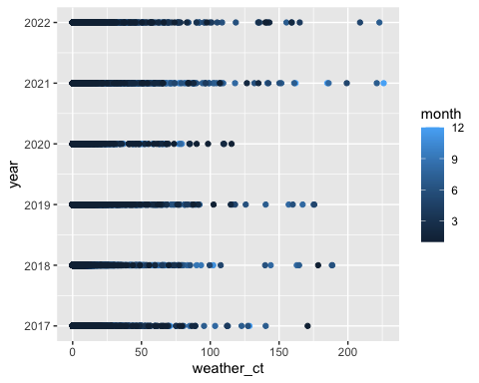
Results (cont.)
Scatter plot graph #1

Slide 21
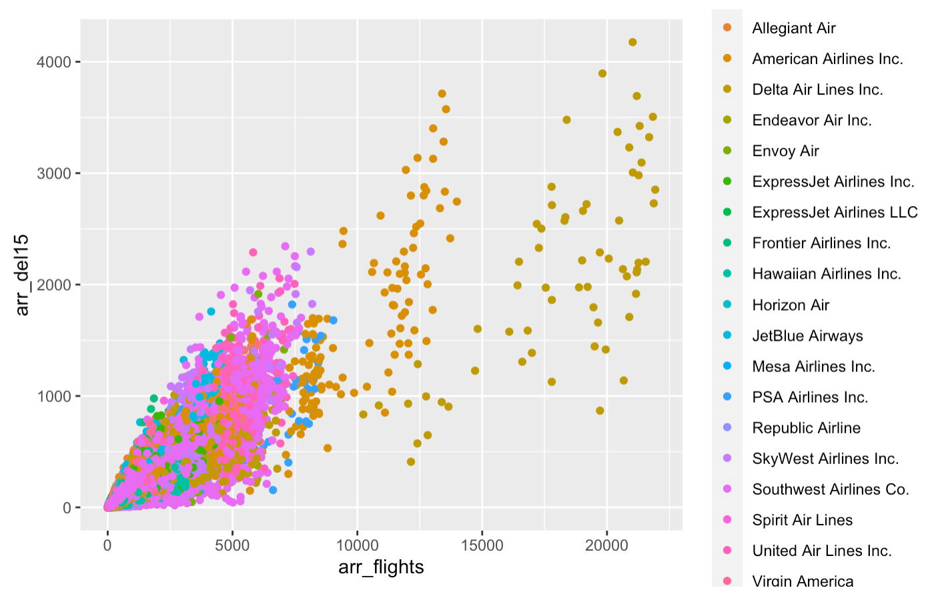
Results (cont.)
Scatter plot graph #2
A ggplot graph that describes the number of flights arriving at airport by the number of flights with more than 15 minutes late
# Generating ggplot graph
ggplot(data, aes(arr_flights, arr_del15, colour = carrier_name)) + geom_point()

Slide 22
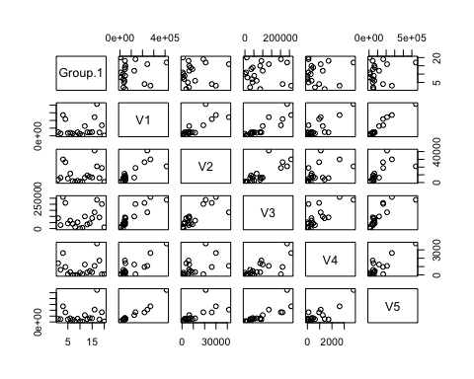
Results (cont.)
Plot graph #3
# Check relations between the delay reasons
plot(delays)

Slide 23
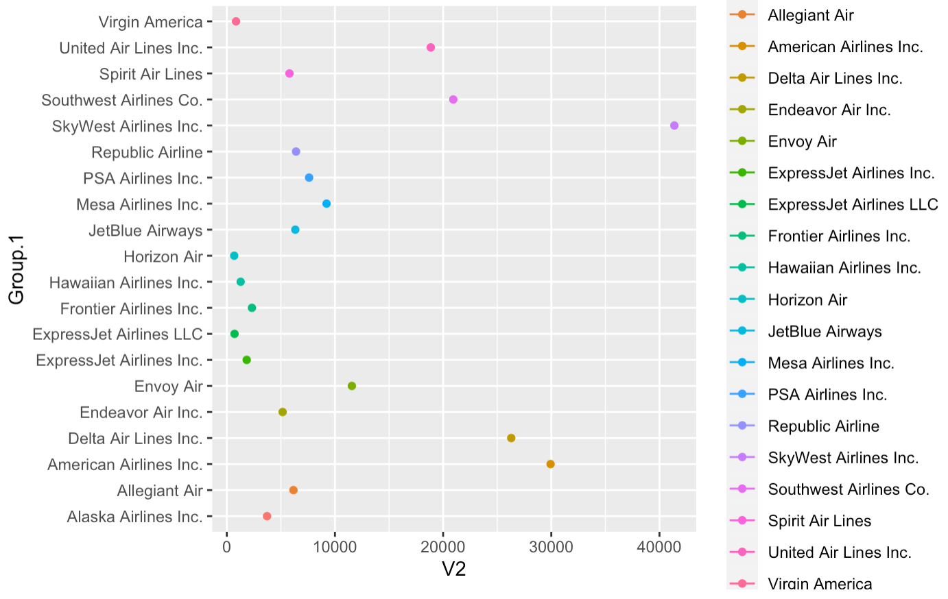
Results
Scatter plot graph #4
A ggplot graph that shows the count of weather delays per carrier.
# Skywest and American airlines got affected the most
ggplot(data=delays, aes(x=V2, y=Group.1, group=Group.1, colour=Group.1)) + geom_line() + geom_point()

Slide 24
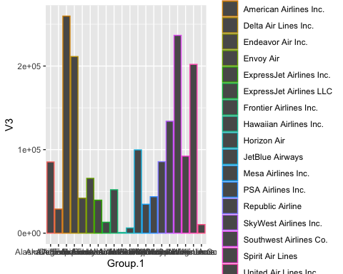
Results
Scatter plot graph #4
A ggplot graph that shows the carrier that was affected the most by the National Aviation Systems (heavy air traffic)
#Delta and Southwest were affected the most
ggplot(data = delays, aes(x=Group.1, y=V3, colour=Group.1)) + geom_col()

Slide 25
Flight Delay from January 2017 - July 2022
Part II
Neysha Pagan
Santiago Lampon
Brandon O’Linn
Justin Washington

Slide 26
Understanding the data (recap)
This dataset has 20 unique carriers and consist of 384 unique airports.
Most of the columns in the dataset are integer and numeric.
The year values goes from 2017 to 2022, and months goes from 1 to 12.
The minimum value across all columns is 0, whereas the maximum value is 429,164.
The maximum value correspond to arr_delay column, which means the total minutes of delayed flight.
429,164 minutes (7,153 hours) of delayed flight!

Slide 27
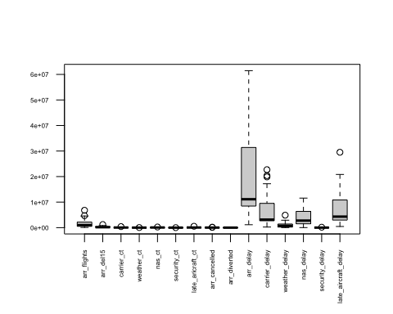
Box Plot
Delay flights for all numeric columns
# Remove first column, the carrier_name column
delays_notname <- delays_all[,2:16]
# Boxplot for all numeric columns in dataset
boxplot(delays_notname, las = 2, xlab = "", ylab = "", cex.lab=1, cex.axis=0.5, method= "jitter")
These boxplots shows the distribution of data based on a five number summary (“minimum”, first quartile [Q1], median, third quartile [Q3] and “maximum”).
Outliers are noticeable in some columns. Further analysis can be made to determine if the maximum value for arr_dealy is an actual value or an outlier.

Slide 28
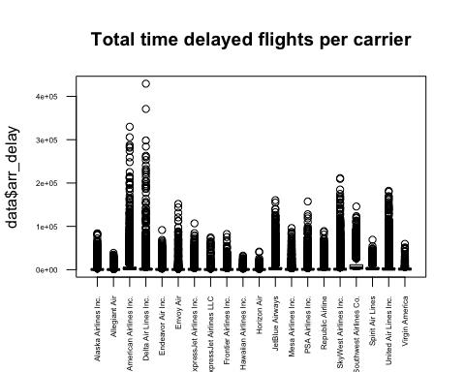
Box Plot (cont.)
Total time of delayed flights per carrier (arr_delay)
# Total time delayed flights per carrier
boxplot(data$arr_delay ~ carrier_name, data = data, las = 2, xlab = "", main="Total time delayed flights per carrier", cex.lab=1, cex.axis=0.5, method= "jitter")
Recall the maximum value for arr_delay is 429,164 which is total minutes of a delayed flight.
That is 7,153 hours or almost 10 months of a delayed flight.
This value corresponds to Delta Air Lines Inc.
The circles represents outliers

Slide 29
Association Rule Discovery
Numeric fields need to be discretized so they can be used for the Apriori algorithm. Char columns need to be converted into factors.
# Convert fields into factor flights <- data #str(flights) flights$carrier <- factor(flights$carrier) flights$carrier_name <- factor(flights$carrier_name) flights$airport <- factor(flights$airport) flights$airport_name <- factor(flights$airport_name) # Discretize arr_flights field min_arr_flights <- min(flights$arr_flights) #min_arr_flights max_arr_flights <- max(flights$arr_flights) #max_arr_flights bins = 20 width=(max_arr_flights - min_arr_flights)/bins; #width
flights$arr_flights = cut(flights$arr_flights, breaks=seq(min_arr_flights, max_arr_flights, width))
# Discretize arr_del15 # Discretize carrier_ct # Discretize weather_ct
# Discretize nas_ct
# Discretize security_ct
# Discretize late_aircraft_ct field # Discretize arr_delay field
# Remove two columns and the last eight columns, and store it in a second variable called flightstemp flightstemp = subset(flights, select = -c(arr_cancelled,arr_diverted,carrier_delay,weather_delay,nas_delay,security_delay,late_aircraft_delay) ) flightstemp <- flightstemp[,(3:14)]

Slide 30
Association Rule Discovery (cont.)
# Creating the rules(general) rules<- apriori(flightstemp, parameter = list(supp=0.01, conf=0.8))
inspect(rules[1:50])
## lhs rhs support confidence coverage lift count ## [6] {carrier_name=Hawaiian Airlines Inc.} => {carrier=HA} 0.012 1.00 0.012 84.22 1203 ## [7] {carrier=HA} => {carrier_name=Hawaiian Airlines Inc.} 0.012 1.00 0.012 84.22 1203 ## [8] {carrier_name=Hawaiian Airlines Inc.} => {carrier_ct=(0,57.4]} 0.011 0.90 0.012 1.07 1077 ## [9] {carrier_name=Hawaiian Airlines Inc.} => {arr_del15=(0,209]} 0.011 0.95 0.012 1.07 1140 ## [10] {carrier_name=Hawaiian Airlines Inc.} => {arr_flights=(0,1.1e+03]} 0.011 0.90 0.012 0.97 1088
:
:
## [27] {carrier=NK} => {carrier_name=Spirit Air Lines} 0.031 1.00 0.031 32.68 3100 ## [28] {carrier_name=Spirit Air Lines} => {carrier=NK} 0.031 1.00 0.031 32.68 3100 ## [29] {carrier=NK} => {late_aircraft_ct=(0,76.6]} 0.026 0.86 0.031 1.11 2669 ## [30] {carrier=NK} => {nas_ct=(0,94.2]} 0.027 0.87 0.031 1.08 2687 ## [31] {carrier=NK} => {carrier_ct=(0,57.4]} 0.027 0.89 0.031 1.06 2765
:
:
## [41] {carrier=B6} => {carrier_name=JetBlue Airways} 0.042 1.00 0.042 23.99 4223 ## [42] {carrier_name=JetBlue Airways} => {carrier=B6} 0.042 1.00 0.042 23.99 4223 ## [43] {carrier=B6} => {late_aircraft_ct=(0,76.6]} 0.034 0.81 0.042 1.05 343

Slide 31
Association Rule Discovery (cont.)
# Sort rules by lift ruleslift<- sort(rules, decreasing = TRUE, by ="lift")
inspect(ruleslift[1:60])
## lhs rhs support confidence coverage lift count ## [1] {carrier_name=Hawaiian Airlines Inc.} => {carrier=HA} 0.012 1 0.012 84 1203 ## [2] {carrier=HA} => {carrier_name=Hawaiian Airlines Inc.} 0.012 1 0.012 84 1203 ## [3] {carrier_name=Hawaiian Airlines Inc., ## carrier_ct=(0,57.4]} => {carrier=HA} 0.011 1 0.011 84 1077 ## [4] {carrier=HA, ## carrier_ct=(0,57.4]} => {carrier_name=Hawaiian Airlines Inc.} 0.011 1 0.011 84 1077
:
:
## [33] {carrier=NK} => {carrier_name=Spirit Air Lines} 0.031 1 0.031 33 3100 ## [34] {carrier_name=Spirit Air Lines} => {carrier=NK} 0.031 1 0.031 33 3100 ## [35] {carrier=NK, ## weather_ct=(0,11.3]} => {carrier_name=Spirit Air Lines} 0.017 1 0.017 33 1761 ## [36] {carrier_name=Spirit Air Lines, ## weather_ct=(0,11.3]} => {carrier=NK} 0.017 1 0.017 33 1761

Slide 32
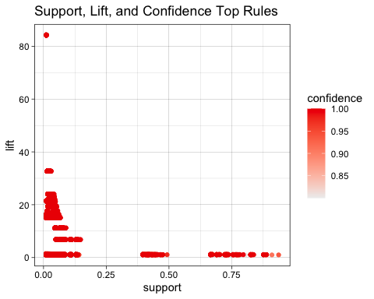
Association Rule Discovery (cont.)
Analyzing rules and plots
# Get summary info about all rules summary(rules)
# Plot rules plot(rules, measure = c("support", "lift"), shading = "confidence" , main = "Support, Lift, and Confidence Top Rules", jitter =0)
Analyzing rules and plots
The summary information are related to Hawaiian Airlines Inc. or Spirit Air Lines.
The reason is because these rules have low support values, a confidence value of 1, and a high lift value that goes from 33 to 84 respectively.

Slide 33
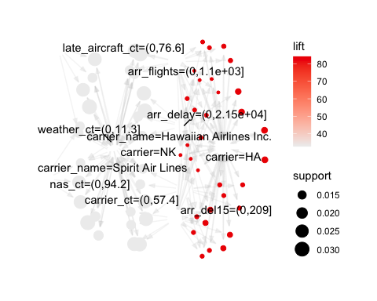
Association Rule Discovery (cont.)
Analyzing rules and plots
rules60<- head(rules, n = 60, by = "lift") inspect(rules60)
# Plot rules plot(rules60, method = "graph")
## lhs rhs support confidence coverage lift count ## [1] {carrier_name=Hawaiian Airlines Inc.} => {carrier=HA} 0.012 1 0.012 84 1203 ## [2] {carrier=HA} => {carrier_name=Hawaiian Airlines Inc.} 0.012 1 0.012 84 1203 ## [3] {carrier_name=Hawaiian Airlines Inc., ## carrier_ct=(0,57.4]} => {carrier=HA} 0.011 1 0.011 84 1077 ## [4] {carrier=HA, ## carrier_ct=(0,57.4]} => {carrier_name=Hawaiian Airlines Inc.} 0.011 1 0.011 84 1077 :
:
:
## [59] {carrier=NK, weather_ct=(0,11.3], ## arr_delay=(0,2.15e+04]} => {carrier_name=Spirit Air Lines} 0.017 1 0.017 33 1720 ## [60] {carrier_name=Spirit Air Lines, ## weather_ct=(0,11.3], ## arr_delay=(0,2.15e+04]} => {carrier=NK} 0.017 1 0.017 33 1720
Analyzing rules and plots
This graph is useful because it help us to understand which items are most frequent for each strongest rule sets. The red circles shows the criteria that occur more often and which are related rather than coincidentally happening together.

Slide 34
Association Rule Discovery (cont.)
# Set carrier as the right hand side of the rules. ## RHS = carrier= HA HArules<- apriori(flightstemp, parameter = list(supp=0.01, conf = 0.80), appearance =list(default = "lhs", rhs="carrier=HA"),control=list(verbose=F)) HArules<- sort(HArules, decreasing = TRUE , by ="confidence") inspect(HArules[1:5])
##RHS = carrier= NK NKrules<- apriori(flightstemp, parameter = list(supp=0.01, conf = 0.90), appearance =list(default = "lhs", rhs="carrier=NK"),control=list(verbose=F)) NKrules<- sort(NKrules, by ="confidence") inspect(NKrules[1:5])
##RHS = carrier = B6 B6rules<- apriori(flightstemp, parameter = list(supp=0.01, conf = 0.90), appearance =list(default = "lhs", rhs="carrier=B6"),control=list(verbose=F)) NKrules<- sort(B6rules, decreasing = TRUE, by ="lift") inspect(B6rules[1:5])

Slide 35
Association Rule Discovery (cont.)
Analyzing rules and plots
## lhs rhs support confidence coverage lift count ## [4] {carrier_name=Hawaiian Airlines Inc., arr_flights=(0,1.1e+03]} => {carrier=HA} 0.011 1 0.011 84 1088
## [2] {carrier_name=Spirit Air Lines, weather_ct=(0,11.3]} => {carrier=NK} 0.017 1 0.017 33 1761
## [3] {carrier_name=JetBlue Airways, late_aircraft_ct=(0,76.6]} => {carrier=B6} 0.034 1 0.034 24 3435
Analylzing carrier= HA
By looking rule #4 for carrier =HA, Hawaiian Airlines Inc. has a high lift value, 84, a confidence value of 1 and a support of 0.011. This means that carrier=HA has a higher chance to have a carrier name of Hawaiian Airlines Inc, and have a range of 0 to 1,100 of delayed arrived flights.
Analylzing carrier= NK
By looking rule#2 for carrier=NK, carrier=NK has a support of 0.017, a confidence value of 1 and lift value of 33. It is highly possible that the carrier name is Spirit Air Lines, and have number of flight delays due to weather within a range of 0 to 11.3.
Analylzing carrier= B6
Rule #3 is related to carrier=B6 which corresponds to JetBlue Airways. This rule has a support of 0.034, a confidence of 1 and a lift of 24. This is not a very strong rule, but this rule suggest that there is likely to have a range of number of flights delayed as a result of another flight on the same aircraft delayed between 0 to 76.6.

Slide 36
Clustering Analysis
K-Means on AD1
# Remove strings from dataset for clustering purposes AD1_km <-AD1[,2:6]
# Set seed for fixed random seed set.seed(123) # run k-means Clusters <- kmeans(AD1_km, 5) AD1_km$Clusters <- as.factor(Clusters$cluster) str(Clusters)
kmeans(AD1_km, 5)
## K-means clustering with 5 clusters of sizes 4, 4, 7, 4, 1
## ## Cluster means: ## sum_carrier_ct sum_weather_ct sum_nas_ct sum_security_ct sum_late_aircraft_ct ## 1 217158 29116 201784 1188 201748 ## 2 11566 886 7644 115 9637 ## 3 38754 6270 43751 264 51836 ## 4 66834 5564 90671 1176 68708 ## 5 413603 20939 236741 3759 546739 ## Clusters ## 1 2 ## 2 5 ## 3 3 ## 4 1 ## 5 4
## Clustering vector: ## [1] 4 3 1 1 3 3 3 2 3 2 2 4 3 3 4 1 5 4 1 2 ## ## Within cluster sum of squares by cluster: ## [1] 2.5e+10 4.3e+08 1.9e+09 8.3e+09 0.0e+00 ## (between_SS / total_SS = 94.6 %)
## ## Available components: ## ## [1] "cluster" "centers" "totss" "withinss" "tot.withinss" ## [6] "betweenss" "size" "iter" "ifault"
Clusters$centers
## sum_carrier_ct sum_weather_ct sum_nas_ct sum_security_ct sum_late_aircraft_ct ## 1 66834 5564 90671 1176 68708 ## 2 217158 29116 201784 1189 201747 ## 3 38754 6270 43751 264 51836 ## 4 413603 20939 236741 3759 546739 ## 5 11566 886 7644 115 9637

Slide 37
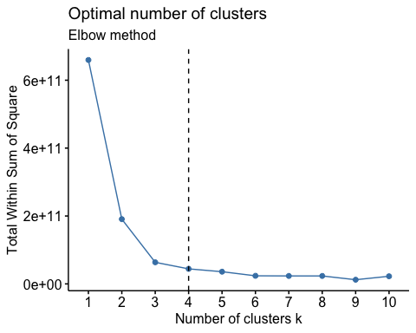
Clustering Analysis (cont.)
Plot Results
# Elbow method fviz_nbclust(AD1_km, kmeans, method = "wss") + geom_vline(xintercept = 4, linetype = 2) + # add line for better visualization labs(subtitle = "Elbow method")

Slide 38
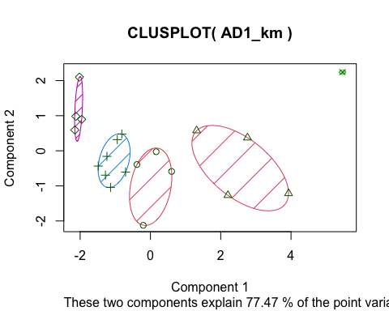
Clustering Analysis (cont.)
Plot Results
# Add clusters to original dataframe AD1_km <- AD1 AD1_km$Clusters <- as.factor(Clusters$cluster).
# Cluster Plot
clusplot(AD1_km, AD1_km$Clusters, color=TRUE, shade=TRUE, labels=0, lines=0)

Slide 39
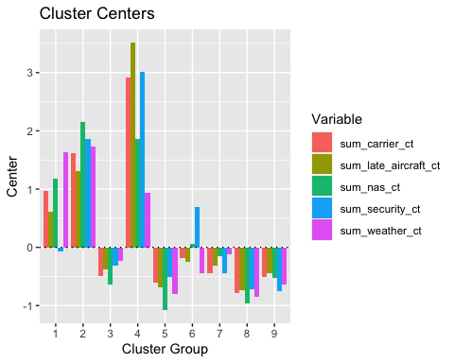
Clustering Analysis (cont.)
Plot Results
# Cluster Centers res_kmeans <- cluster_analysis(AD1_km, n = 9, method = "kmeans") plot(summary(res_kmeans))

Slide 40
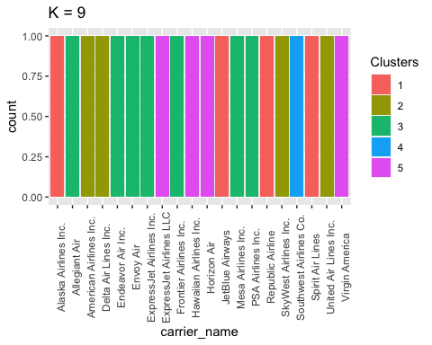
Clustering Analysis (cont.)
Plot Results
# Carriers per clusters ggplot(data=AD1_km, aes(x=carrier_name, fill=Clusters))+ geom_bar(stat="count") + labs(title = "K = 9") + theme(axis.text.x = element_text(angle = 90))

Slide 41
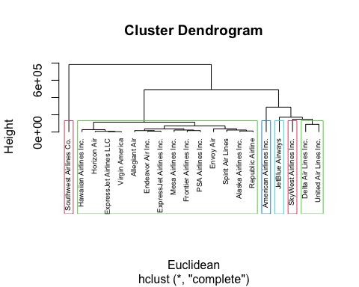
Hierarchical Clustering Algorithms (HAC)
Cluster Dendrograms
# Set carrier names as row names AD1_HAC <- AD1 rownames(AD1_HAC) <- AD1_HAC$carrier_name
Euclidean <- dist(AD1_HAC, method = "euclidean")
Maximum <- dist(AD1_HAC, method = "maximum")
Manhattan <- dist(AD1_HAC, method = "manhattan")
Canberra <- dist(AD1_HAC, method = "canberra") Binary <- dist(AD1_HAC, method = "binary")
Minkowski <- dist(AD1_HAC, method = "minkowski")
# Euclidean Dendrogram
HAC <- hclust(Euclidean, method="complete") plot(HAC, cex=0.6, hang=-1) rect.hclust(HAC, k =6, border=2:5)

Slide 42
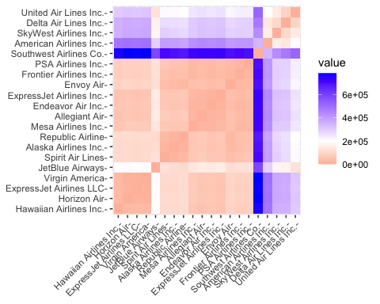
Distance Matrix Computation and Visualization
# Euclidean Distance Matrix fviz_dist(Euclidean)

Slide 43
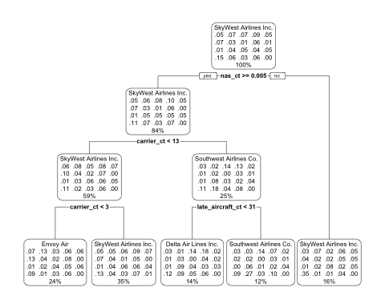
Decision Tree
train_tree <-rpart(carrier_name ~., data = train_data, method="class", control=rpart.control(minsplit=2, cp=0.001)) # Training and test sets of data sample_data = sample.split(AD1, SplitRatio = 0.8) train_data <- subset(AD1, sample_data == TRUE) test_data <- subset(AD1, sample_data == FALSE) #Train Tree model train_tree <-rpart(carrier_name ~., data = train_data, method="class", control=rpart.control(cp=0, maxdepth = 3, minsplit = 2)) #Decision Tree rpart.plot(train_tree, box.palette=0)

Slide 44
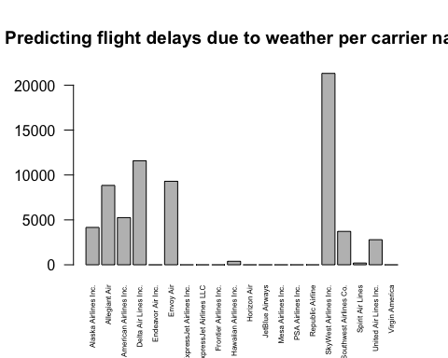
Decision Tree (cont.)
train_tree <-rpart(carrier_name ~., data = train_data, method="class", control=rpart.control(minsplit=2, cp=0.001))
# Predicting the model predicted=predict(train_tree,train_data,type="class") plot(predicted, main= "Predicting flight delays due to weather per carrier name", las = 2, cex.axis=1, cex.names=0.5)

Slide 45
Naïve Bayes
Frequencies
The xtabs() function is used to create a contingency table from cross-classifying factors, usually contained in a data frame, using a formula interface.
Freq <- xtabs(~carrier_name, data = AD1) Freq
set.seed(1234) ind <- sample(2, nrow(AD1), replace = T, prob = c(0.8, 0.2)) train <- AD1[ind == 1,] test <- AD1[ind == 2,]
Skywest Airlines Inc. came out as the carrier with the highest frequency with 14,919 of being affected with some sort of delay.
Out of the bigger carriers, Delta came in first with a frequency of 9,045.
According to this test, one should avoid Skywest and Delta to lesser your chances of incurring some type of delay on your flight.

Slide 46
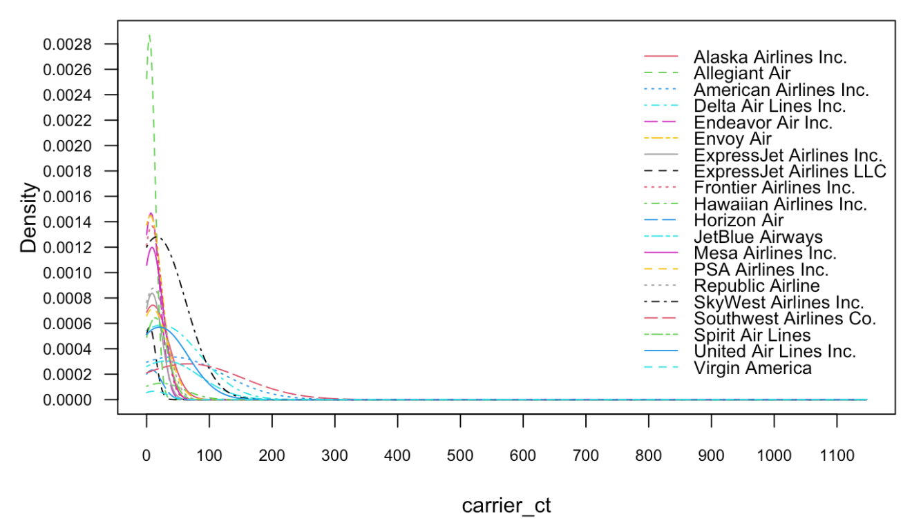
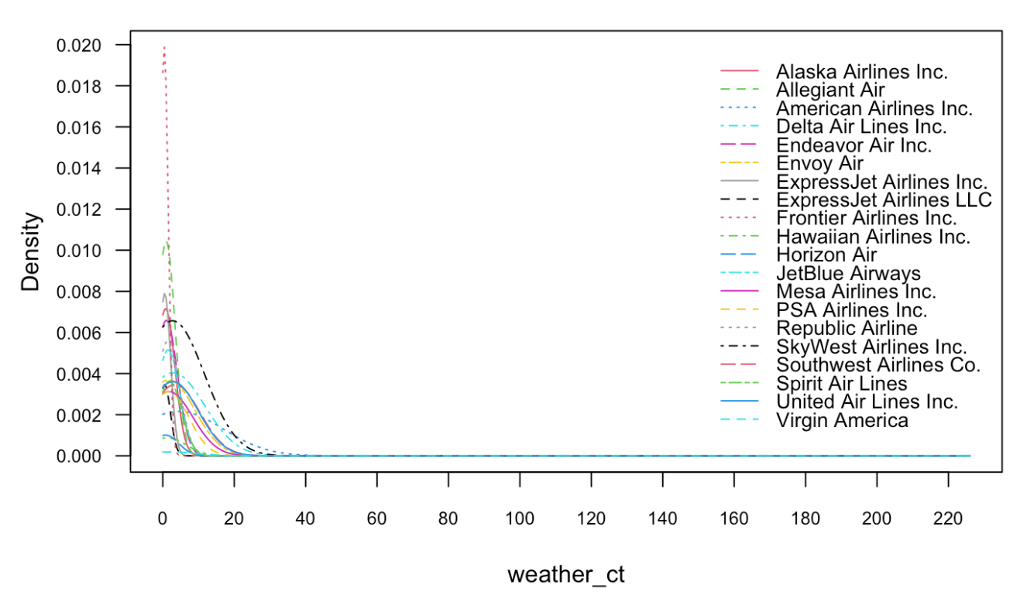
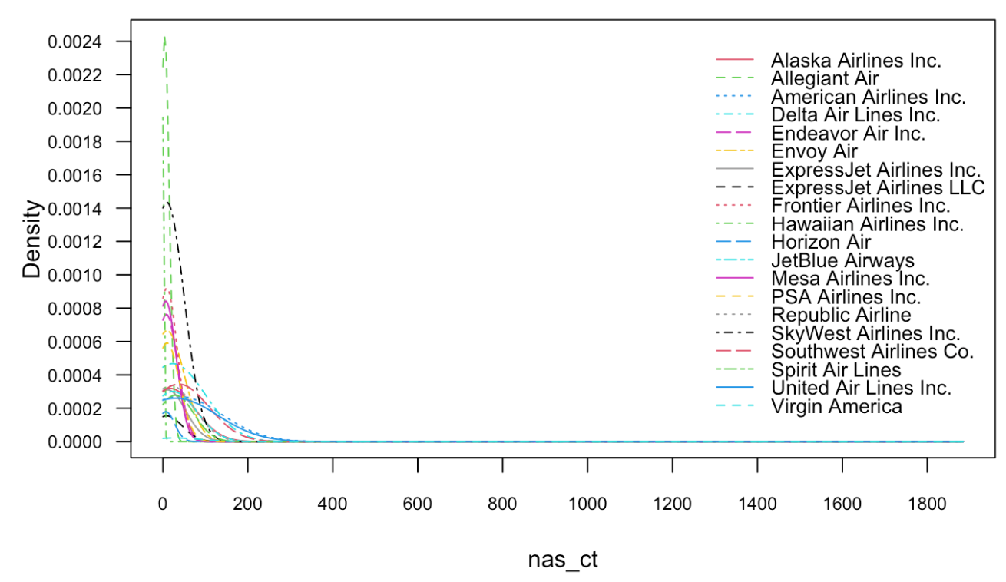
Naïve Bayes (cont.)
Naïve Bayes Function
The general function naive_bayes() detects the class of each feature in the dataset and, depending on the user choices, assumes possibly different distribution for each feature. It currently supports following class conditional distributions.
The next model shows density plots of how different carriers get affected by every different type of delays.
model <- naive_bayes(carrier_name ~ ., data = train, usekernel = F) plot(model)

Slide 47
Naïve Bayes (cont.)
Naïve Bayes Function
For carrier delays we can see Allegiant Air got affected the most.
Weather delays affected Frontier Airlines the most and for nas delays brought Allegiant Air in first.
For security delays, United Airlines took the prize and lastly for late aircraft delays it went to Allegiant Air.
Looking at the density numbers for this model, one could safely assume to avoid Allegiant Air to avoid any delay when it came in as the highest density in three of the five charts.
That being said, Skywest Airline Inc. came in second against most of the different delays. Combining the frequency and density charts than Skywest Airlines Inc. has the biggest red flag and one to really avoid to decrease your chances of being delayed for a flight.

Slide 48
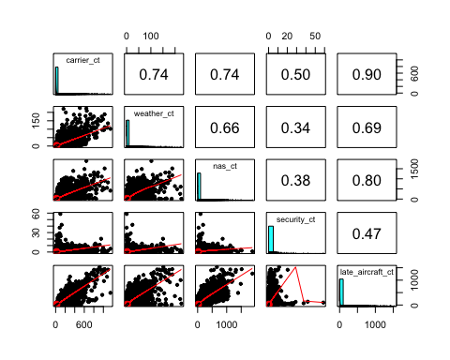

Naïve Bayes (cont.)
Paris Panels
A pairs plot is a matrix of scatterplots that let you understand the pairwise relationship between different variables in a dataset. Fortunately it’s easy to create a pairs plot in R by using the pairs() function. Correlation shows the strength of a relationship between two variables and is expressed numerically by the correlation coefficient.
In the next panel we can see that the highest correlation comes between carrier and late carrier. This correlation is easily understandable because when the aircrafts create a delay it will trigger the late aircraft delay variable. This correlation came in at 90%. The second highest correlation came in between air traffic delay and late aircraft delay at 80%.
pairs.panels(AD1[-1])
pairs.panels(train[-1])

Slide 49
Key questions about the data
1. Which airlines typically have significant flight delays?
The airlines with most significant flight delays are
Southwest Airlines Co. 132,398,304.25
American Airlines Inc. 116,828,009.76
SkyWest Airlines Inc. 107,692,923.86
Delta Air Lines Inc. 89,618,221.94
2. Which airports typically have significant flight delays?
The affected airports that have significant flights delays are
Albuquerque, NM: Albuquerque International Sunport, New Mexico
Arcata/Eureka, CA: California Redwood Coast Humboldt County, California
3. Which time of year, and month typically have the most flight delays?
December of 2019 was the month that had most flight delays, with a total number of 1,812 occurrences.
SkyWest Airlines Inc. airline had the higher number of events, with a total of 256 occurrences in December 2019
4. Which airlines typically have significant flight delays?
SkyWest Airlines Inc. and Southwest Airlines Co. are the carriers with higher number of delays

Slide 50


Questions?
This Photo by Unknown Author is licensed under CC BY

